Slide 1


REAL-TIME STRAND-BASED HAIR RENDERING USING GUIDE HAIR INTERPOLATION AND DEPTH PEELING
SUPERVISOR: RECHARD LEE
JONATHAN LIEW EU JIN
BS20110240

Slide 2
INTRODUCTION
PROBLEM BACKGROUND
Rendering hair in real time is a challenge (Ou et al., 2012)
Highly overlapping hair strands produce incorrect occlusion (Friederichs et al., 2020)

Slide 3
INTRODUCTION
AIM
Render hair geometry in real-time.
Adapt order-independent transparency on hair strands.
OBJECTIVES
To render hair geometry in real-time using guide hair interpolation.
To adapt order-independent transparency for correct occlusion of hair strands using depth peeling.
SCOPE
Hair will be rendered in dry conditions only.
Hair strands are rendered as a hairball on a sphere model.
Hair will be rendered using different hair type setups.
Only one light source is set up in the scene.

Slide 4
LITERATURE REVIEW
REPRESENTATION
Explicit Strands
Represented strands as arrays of 2D line segments (LeBlanc et al., 1991)
Expand lines into triangles to add detail to 3D strand (Chang et al, 2002)
Implicit Volume
Treat as a single mesh using volume density functions (Yang et al., 2000)
Wang et al. (2022) reconstructed volume using subset of guide hairs.

Slide 5
LITERATURE REVIEW
ILLUMINATION
Kajiya & Kay (1989)
Single light-scattering model
Involves specular and diffuse light components
Cons: not physically accurate
Marschner et al. (2003)
Bidirectional scattering model involving transmission and reflection rays
Cons: too expensive for real-time applications

Slide 6
CONTENTS
LITERATURE REVIEW
TRANSPARENCY
CHAPTER 1 INTRODUCTION
CHAPTER 3
METHODOLOGY
Alpha Blending
(Zinke et al., 2004) blends fragment from back to front
Cons: Highly overlapping hair strands are hard to be sorted (Friederichs et al., 2020)
Depth peeling
Order-independent transparency (Tsopouridis et al., 2023)
Peels layers in the scene
Sorting is done per fragment until there are no more fragments drawn

Slide 7
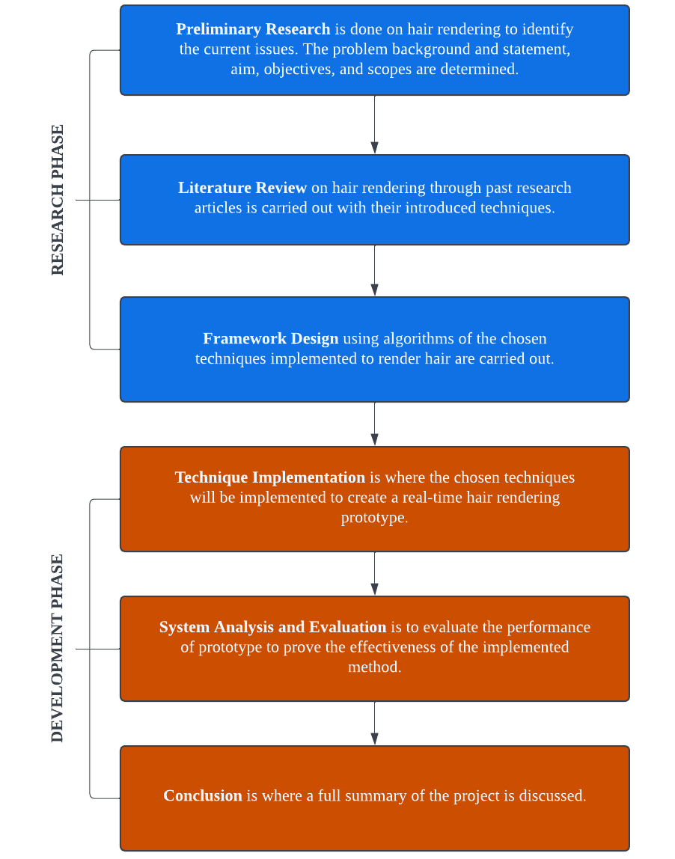
METHODOLOGY
PROJECT FRAMEWORK

Slide 8
METHODOLOGY
SYSTEM ARCHITECTURE

Slide 9
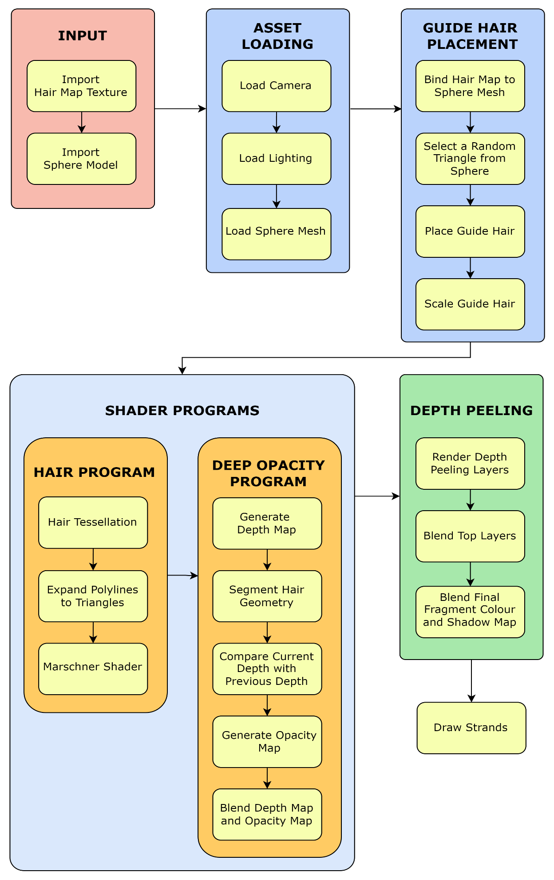

Slide 10
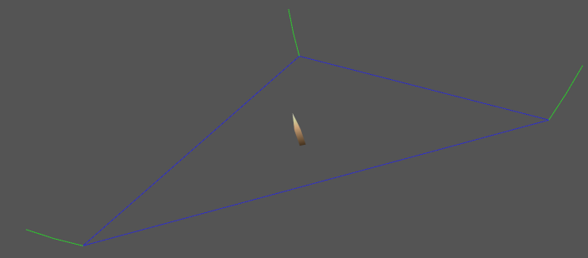
METHODOLOGY
GUIDE HAIR PLACEMENT
Map imported texture on to sphere
A random triangle on the sphere is selected
A random point within the triangle is chosen
Alpha values are fetched from the hair map’s texture coordinates

Slide 11
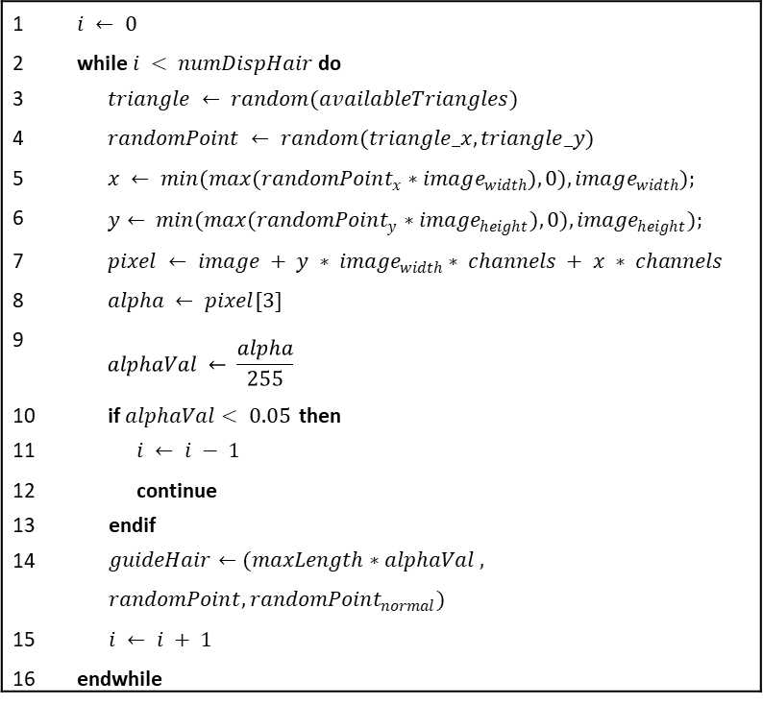
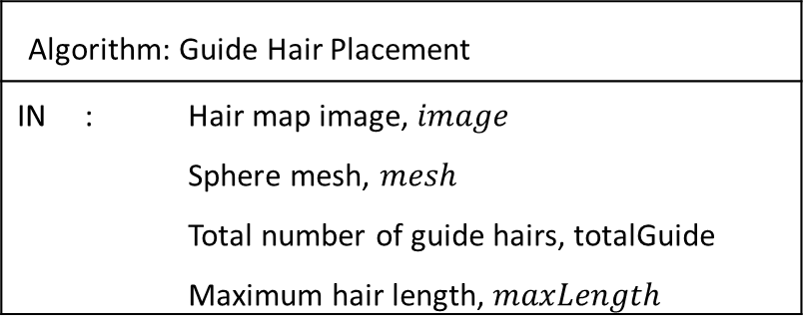
METHODOLOGY
GUIDE HAIR PLACEMENT
1 | $$i ← 0$$
2 | while $i < numDispHair$ do
3 | $$triangle ← random(availableTriangles)$$
4 | $$randomPoint ← random(triangle_x,triangle_y)$$
5 | $$x ← min(max(randomPoint_{x}∗image_{width}), 0), image_{width});$$
6 | $$y← min(max(randomPoint_{y}∗image_{height}), 0), image_{height});$$
7 | $$pixel ← image + y ∗ image_{width}∗ channels + x ∗ channels$$
8 | $$alpha ← pixel[3]$$
9 | $$alphaVal ← \frac{alpha}{255}$$
10 | if $alphaVal< 0.05$ then
11 | $$i ← i − 1$$
12 | continue
13 | endif
14 | $$guideHair←(maxLength∗alphaVal , randomPoint, randomPoint_{normal})$$
15 | $$i ← i + 1$$
16 | endwhile
Algorithm: Guide Hair Placement
IN | : | Hair map image, $image$ Sphere mesh, $mesh$ Total number of guide hairs, totalGuide Maximum hair length, $maxLength$

Slide 12
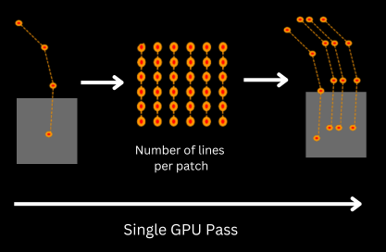
METHODOLOGY
HAIR INTERPOLATION
To generate more hair strands through interpolation using a single guide hair
Only a single GPU pass is used for each guide hair

Slide 13
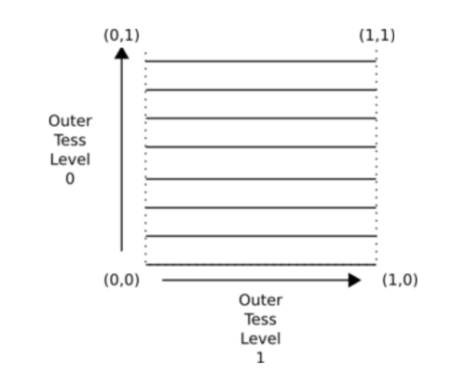
METHODOLOGY
HAIR INTERPOLATION
Level 0 → number of isolines per patch
Level 1 → number of line segments

Slide 14
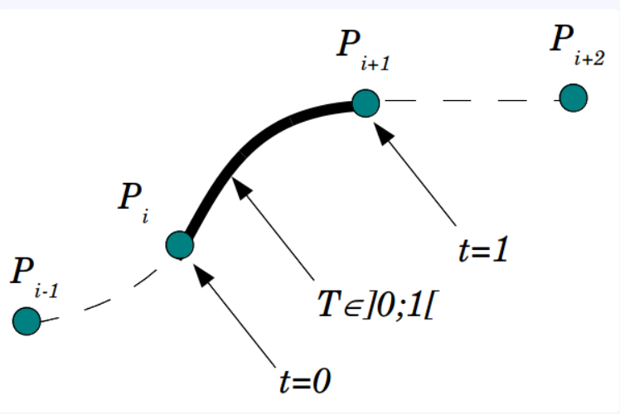
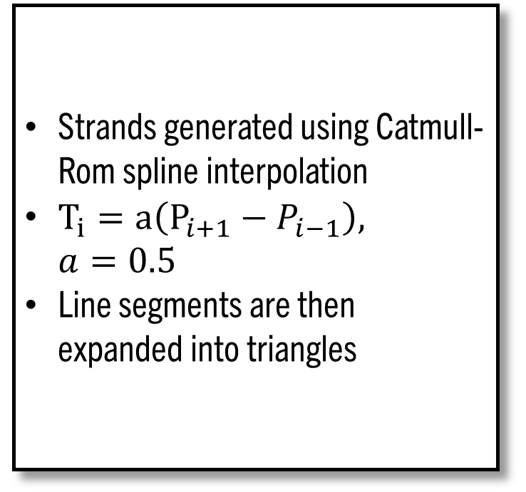
METHODOLOGY
HAIR INTERPOLATION
Strands generated using Catmull-Rom spline interpolation
$T_{i}=a\left(P_{i+1}−P_{i−1}\right),$ $a=0.5$
Line segments are then expanded into triangles

Slide 15
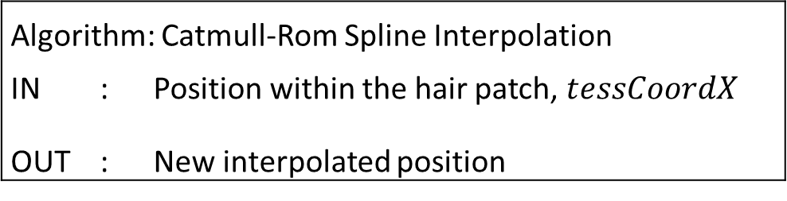
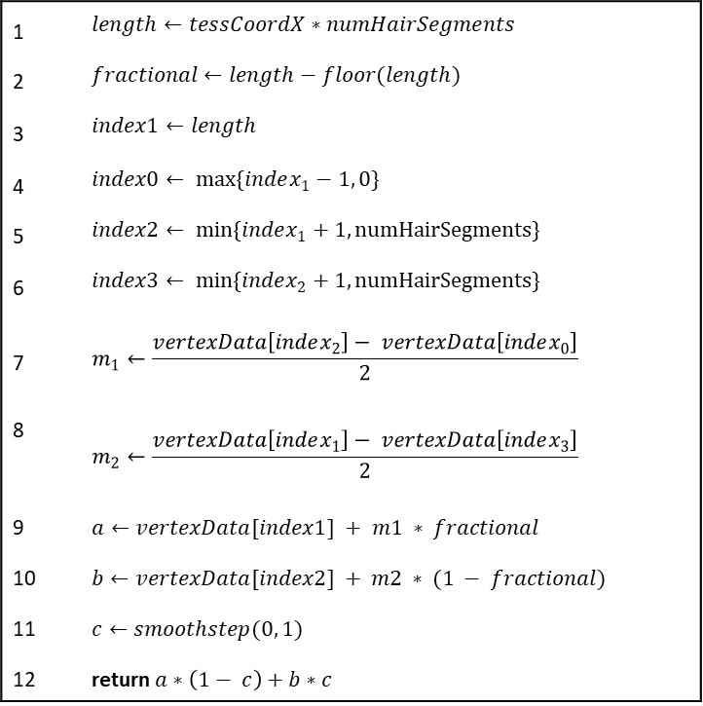
METHODOLOGY
HAIR INTERPOLATION
1 | $$length←tessCoordX∗numHairSegments$$
2 | $$fractional←length−floor(length)$$
3 | $$index1←length$$
4 | $$index0← max\{index_{1}−1, 0\}$$
5 | $$index2← min\{index_{1}+1, numHairSegments\}$$
6 | $$index3← min\{index_{2}+1, numHairSegments\}$$
7 | $$m_{1}←\frac{vertexData\left[index_{2}\right]− vertexData\left[index_{0}\right]}{2}$$
8 | $$m_{2}←\frac{vertexData\left[index_{1}\right]− vertexData\left[index_{3}\right]}{2}$$
9 | $$a←vertexData[index1] + m1 ∗ fractional$$
10 | $$b←vertexData[index2] + m2 ∗ (1 − fractional)$$
11 | $$c←smoothstep(0, 1)$$
12 | return $a∗\left(1− c\right)+b∗c$
Algorithm: Catmull-Rom Spline Interpolation
IN OUT | : : | Position within the hair patch, $tessCoordX$ New interpolated position

Slide 16
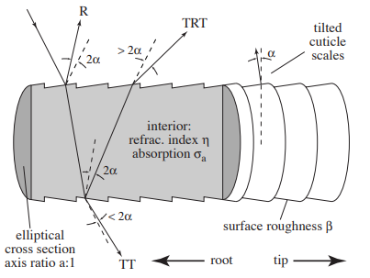
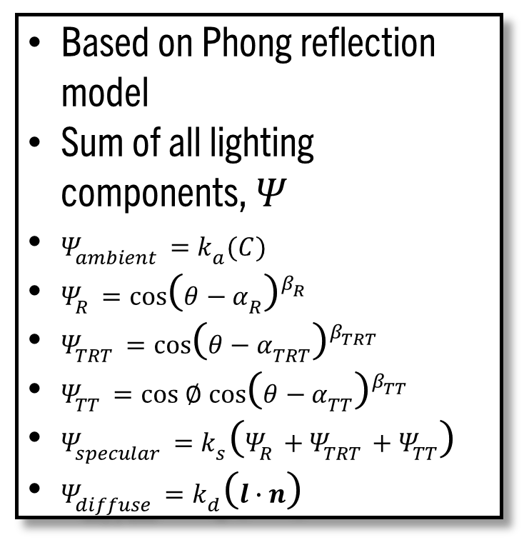
METHODOLOGY
MARSCHNER SHADER
Based on Phong reflection model
Sum of all lighting components, $Ψ$
$Ψ_{ambient}=k_{a}(C)$
$Ψ_{R}=\cos{{\left(θ−α_{R}\right)}^{β_{R}}}$
$Ψ_{TRT}=\cos{{\left(θ−α_{TRT}\right)}^{β_{TRT}}}$
$Ψ_{TT}=\cos{∅}\cos{{\left(θ−α_{TT}\right)}^{β_{TT}}}$
$Ψ_{specular}=k_{s}\left(Ψ_{R}+Ψ_{TRT}+Ψ_{TT}\right)$
$Ψ_{diffuse}=k_{d}\left(l∙n\right)$

Slide 17
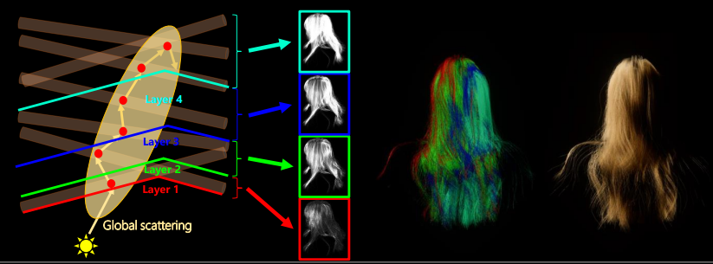
METHODOLOGY
DEEP SHADOW MAPS
Two render passes - generate depth maps, generate opacity maps
Layer hair geometry
Set intensity values of respective colour channels based on layers
Layer size = 0.0005

Slide 18
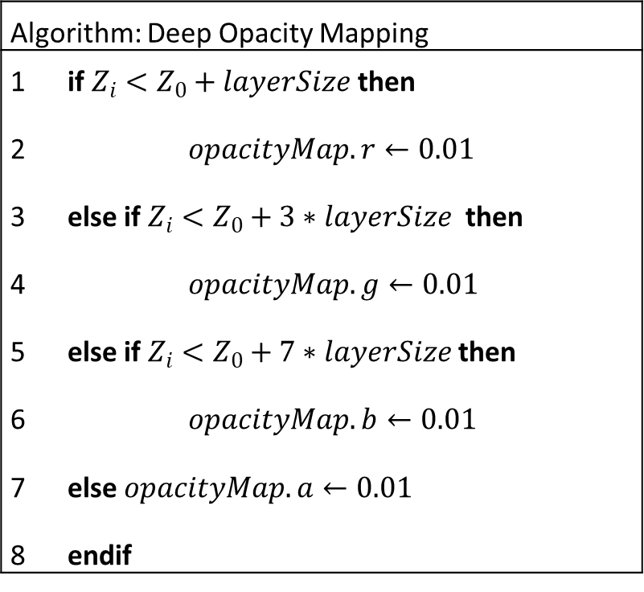
METHODOLOGY
DEEP SHADOW MAPS
Algorithm: Deep Opacity Mapping
1 2 3 4 5 6 7 8 | if $Z_{i}<Z_{0}+layerSize$ then $opacityMap.r←0.01$ else if $Z_{i}<Z_{0}+3∗layerSize$ then $opacityMap.g←0.01$ else if $Z_{i}<Z_{0}+7∗layerSize$ then $opacityMap.b←0.01$ else $opacityMap.a←0.01$ endif

Slide 19
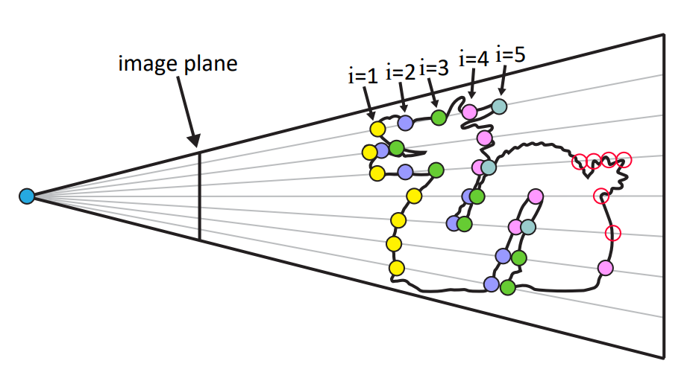
METHODOLOGY
DEPTH PEELING
Two geometry layers are used
Two depth buffers are required
Current pixel's depth is compared to the stored depth from the previous pass
If it is closer to the camera, the pixel colour is discarded.
Layers are blended using alpha blending

Slide 20
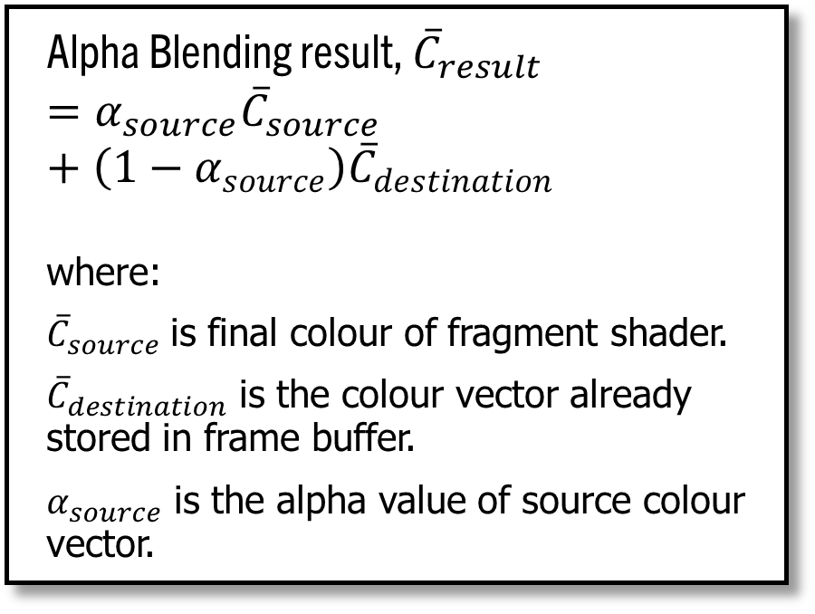
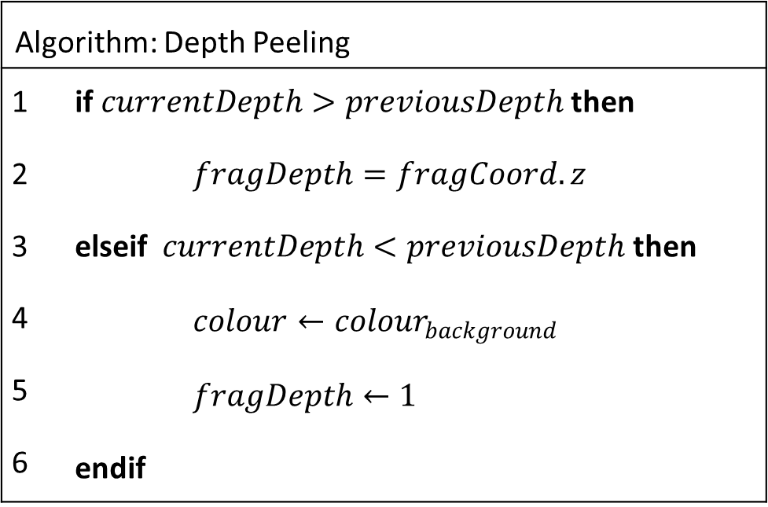
METHODOLOGY
DEPTH PEELING
Alpha Blending result, ${\overline{C}}_{result}$
$$=α_{source}{\overline{C}}_{source}+\left({1−α}_{source}\right){\overline{C}}_{destination}$$
where:
${\overline{C}}_{source}$ is final colour of fragment shader.
${\overline{C}}_{destination}$ is the colour vector already stored in frame buffer.
$α_{source}$ is the alpha value of source colour vector.
Algorithm: Depth Peeling
1 2 3 4 5 6 | if $currentDepth>previousDepth$ then $fragDepth=fragCoord.z$ elseif $currentDepth<previousDepth$ then $colour←{colour}_{background}$ $fragDepth←1$ endif

Slide 21
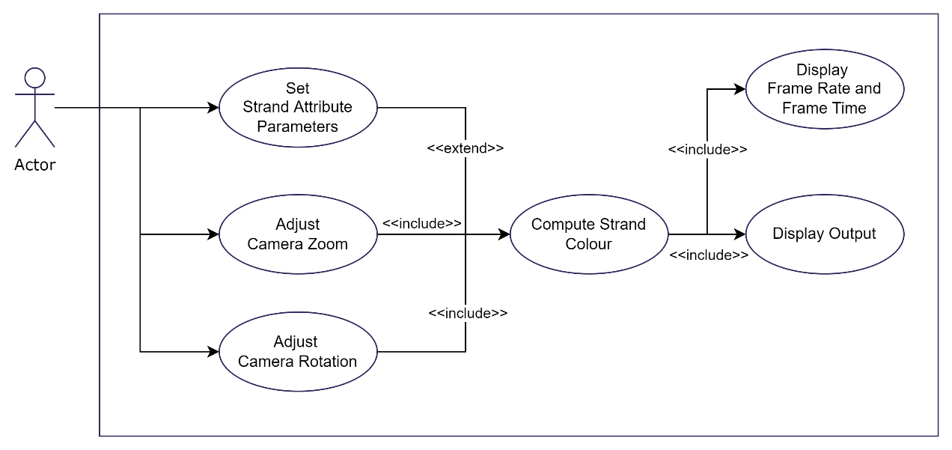
SYSTEM DESIGN AND IMPLEMENTATION
USE CASE DIAGRAM

Slide 22
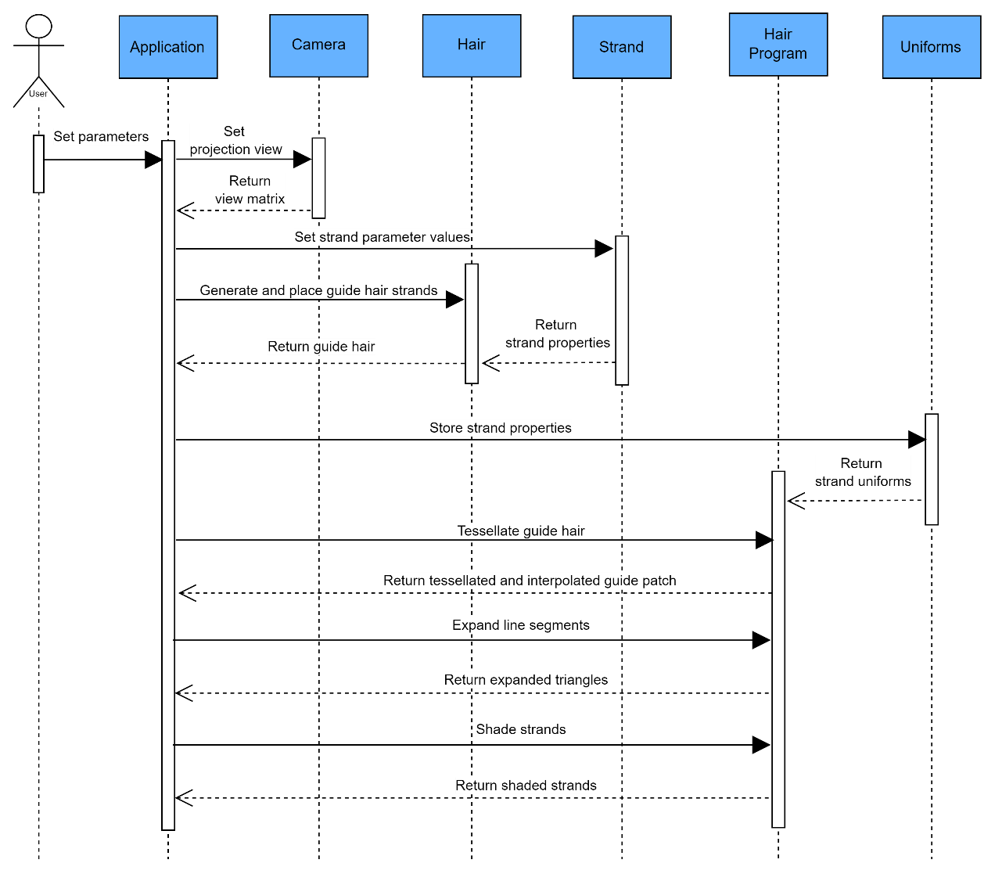
SYSTEM DESIGN AND IMPLEMENTATION
SEQUENCE DIAGRAM

Slide 23
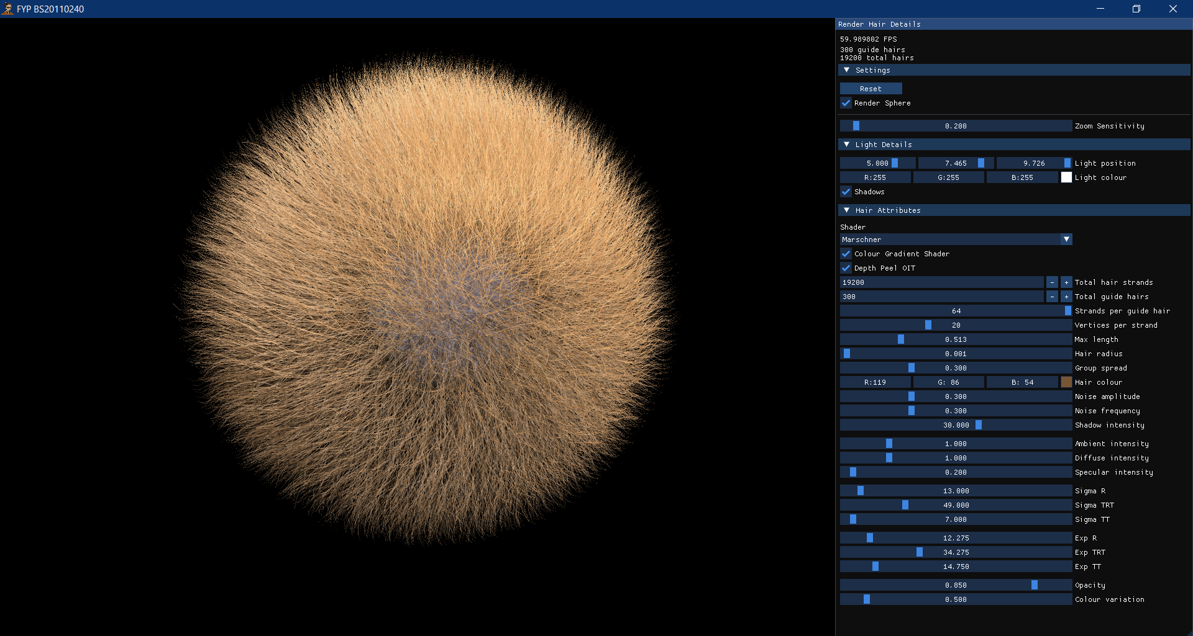
SYSTEM DESIGN AND IMPLEMENTATION
SAMPLE OUTPUT OF GUI

Slide 24
EXPERIMENTAL SETUP
Virtual Environment: Microsoft Visual Studio 2019
Programming Language: C++
Libraries: OpenGL, ImGUI, GLM, SOIL2, Assimp
Hardware:
ASUS TUF Gaming F15
Random-access Memory (RAM) : 16.0 GB (15.8 GB usable)
Graphics : NVIDIA GeForce GTX 1650

Slide 25
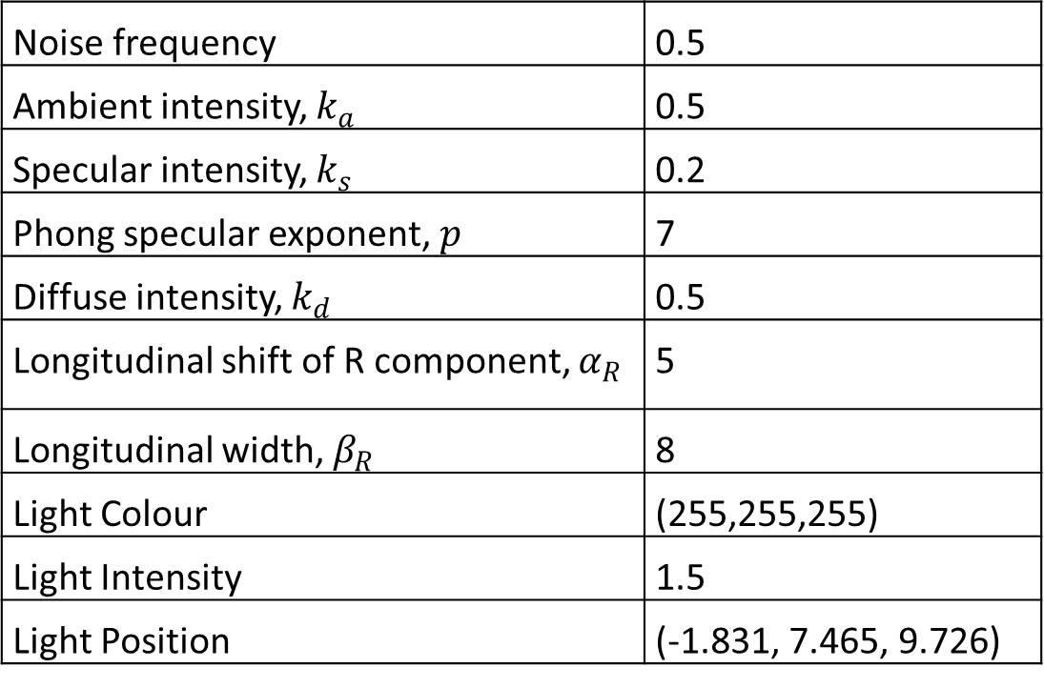
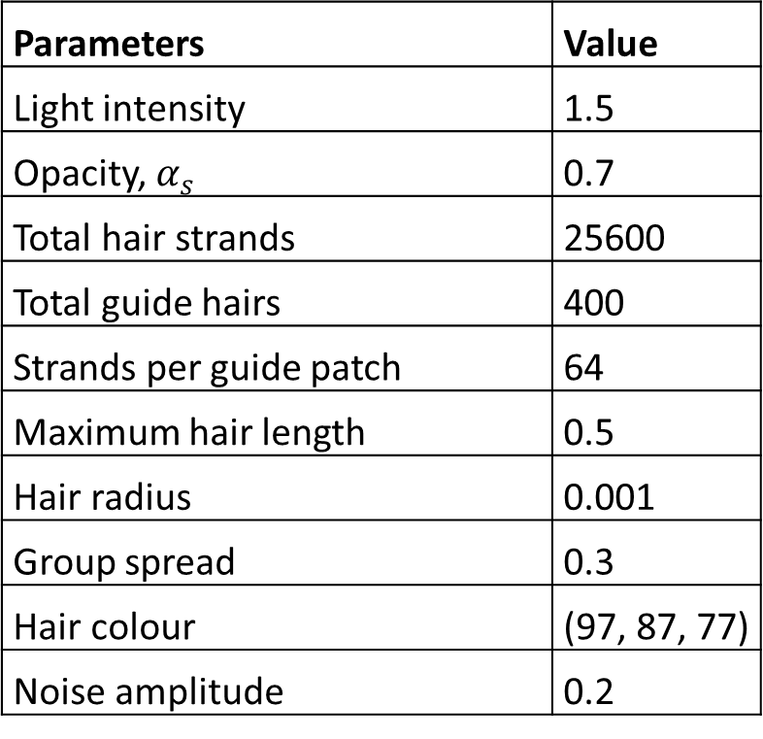
EXPERIMENTAL SETUP
DEFAULT PARAMETERS
Parameters | Value
Light intensity | 1.5
Opacity, $α_{s}$ | 0.7
Total hair strands | 25600
Total guide hairs | 400
Strands per guide patch | 64
Maximum hair length | 0.5
Hair radius | 0.001
Group spread | 0.3
Hair colour | (97, 87, 77)
Noise amplitude | 0.2
Noise frequency | 0.5
Ambient intensity, $k_{a}$ | 0.5
Specular intensity, $k_{s}$ | 0.2
Phong specular exponent, $p$ | 7
Diffuse intensity, $k_{d}$ | 0.5
Longitudinal shift of R component, $α_{R}$ | 5
Longitudinal width, $β_{R}$ | 8
Light Colour | (255,255,255)
Light Intensity | 1.5
Light Position | (-1.831, 7.465, 9.726)

Slide 26
EXPERIMENTAL SETUP
HAIR TYPE SETUPS
i. Normal hair
Maximum hair length = 0.5 and noise amplitude = 0.1.
ii. Curly hair
Maximum hair length = 0.5 and noise amplitude = 0.5.
iii. Long hair
Maximum hair length = 1.0 and noise amplitude = 0.1.
iv. Long and curly hair
Maximum hair length = 1.0 and noise amplitude = 0.5.

Slide 27
EXPERIMENTAL SETUP
Captures done in scene viewport resolution of 1920x1080
Uses one key light (point light) as light source
Uses stated default parameters
Performance testing captured using NVIDIA’s Nsight Graphics Tool
Some parameters will be modified for performance comparisons
Performance tests repeated for 5 iterations
All tests were done for 60 seconds to obtain the average frame rate and frame time for each iteration

Slide 28
RESULTS AND DISCUSSION
PERFORMANCE OF MARSCHNER SHADER
Performance tests are done using
different number of guide hair strands with a constant total number of hair strands
different hair type setups with constant total number of hair strands
different total number of hair strands with a constant number of strands per guide patch
where tests are done with shadowing enabled

Slide 29
RESULTS AND DISCUSSION
PERFORMANCE OF MARSCHNER SHADER
Average frame rate and frame time of simulation under different total number of guide hair strands used in 60 seconds. Total number of hair strands are kept constant at 25600 strands.
Total Number of Guide Hairs | Frame Rate (fps) | Frame Time (ms)
400 | 56.02 | 17.85
800 | 30.30 | 33.00
1600 | 15.70 | 63.69
3200 | 8.10 | 123.46

Slide 30
RESULTS AND DISCUSSION
PERFORMANCE OF MARSCHNER SHADER
Rendering performance with increasing number of guide hairs used

Slide 31
RESULTS AND DISCUSSION
PERFORMANCE OF MARSCHNER SHADER
Frame rate drops with more guide hairs used.
400 guide hairs achieved highest performance.
Performance drops below minimum real-time performance after the 800 guide hairs mark.
More hair strands are required to be simulated.
Less hairs are interpolated within each guide patch.
More GPU passes are required
More time is required to render hair geometry, therefore frame rate decreases.

Slide 32
RESULTS AND DISCUSSION
PERFORMANCE OF MARSCHNER SHADER
Average frame rate and frame time of simulation under different hair type setups in 60 seconds
Hair Type | Frame Rate (fps) | Frame Time (ms)
Normal | 56.02 | 17.85
Curly | 49.14 | 20.35
Long | 53.68 | 18.63
Long and Curly | 44.58 | 22.43

Slide 33
RESULTS AND DISCUSSION
PERFORMANCE OF MARSCHNER SHADER
Average frame times of different hair type setups

Slide 34
RESULTS AND DISCUSSION
PERFORMANCE OF MARSCHNER SHADER
All hair type setups achieved real-time performance.
Normal hair achieved the highest performance while long and curly hair achieved the lowest performance.
Longer hair requires generation and rendering of longer line segment geometry.
Noise used to create curly hair adds disturbance to the geometric structure.
Rendering curly hair requires a longer computation time than rendering longer hair.
Combination of both adds the most stress, thus taking longest to render.

Slide 35
RESULTS AND DISCUSSION
PERFORMANCE OF MARSCHNER SHADER
Average frame rate and frame time of simulation under different total number of strands used in 60 seconds
Total Number of Hair Strands | Frame Rate (fps) | Frame Time (ms)
25600 | 56.02 | 17.85
32000 | 47.17 | 21.20
38400 | 39.49 | 25.32
44800 | 34.64 | 28.87
51200 | 31.72 | 31.53

Slide 36
RESULTS AND DISCUSSION
PERFORMANCE OF MARSCHNER SHADER
Rendering performance with increasing total number of hair strands used

Slide 37
RESULTS AND DISCUSSION
PERFORMANCE OF MARSCHNER SHADER
Frame rate drops with more strands are rendered in the scene.
More GPU passes are required
More time is required to render hair geometry
Drop in performance; frame rate decreases.
25600 total strands achieved the highest performance.
Shader still achieves real-time performance, even when rendering 51200 hair strands

Slide 38
RESULTS AND DISCUSSION
PERFORMANCE OF MARSCHNER SHADER
Implementation of hair interpolation improves the hair rendering performance.
Interpolation allows rendering of hair strands in real time with different hair type setups and with different total hair strands of up to about 50000 strands.

Slide 39
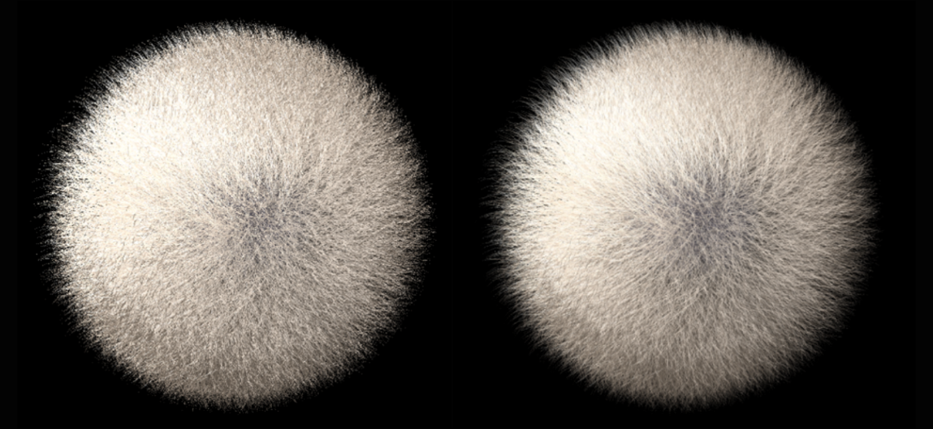
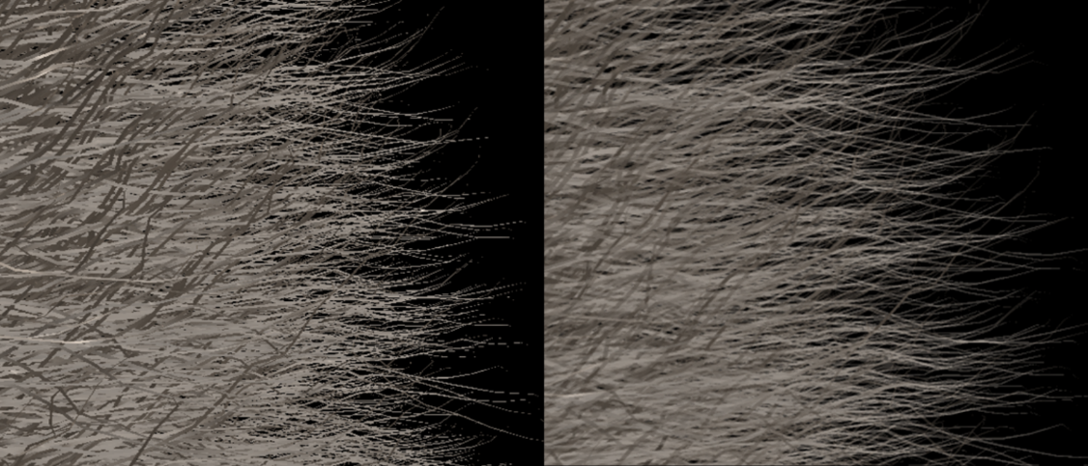
RESULTS AND DISCUSSION
VISUAL RESULT OF DEPTH PEELING
Figures show hairball models without (left) and with depth peeling transparency.
The visual appearance of hair without accounting for hair transparency looks dull and lacks depth, as illustrated in left figures.
Reduces rough and aliased edges (caused by sub-pixel geometry) at the tip of strands through blending effect.
More physically accurate as hair fibers are translucent.

Slide 40
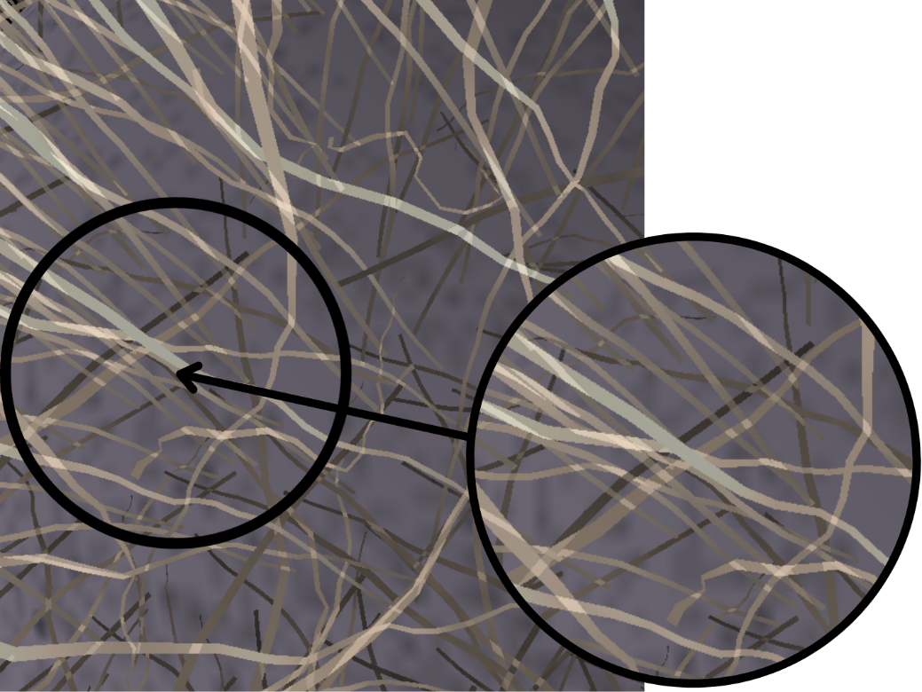
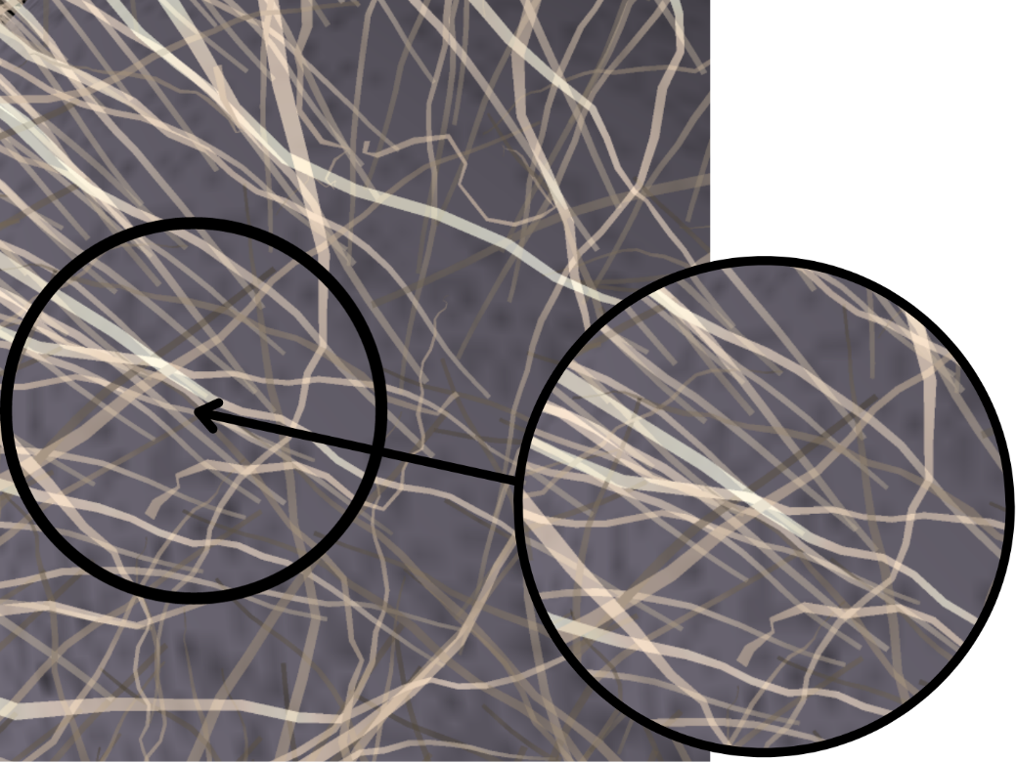
Hair model with traditional alpha blending hair model (left) and depth peeling (right)
Left figure shows strands with incorrect occlusion.
Strands can only be sorted based on depth values from the virtual camera as strands are overlapping.
Results in render with fragments blended together; an average of all the contributing hair fragments.
Incorrect occlusion is handled in the right figure.
Hair geometry is peeled in layers along view direction; scene is sorted based on pixels.

Slide 41
CONCLUSION
SUMMARY
Both objectives were achieved.
Implementation of hair interpolation when rendering hair geometry achieved real-time performance.
Depth peeling handled incorrect occlusion caused by overlapping hair strands.

Slide 42
CONCLUSION
CONTRIBUTIONS
Improving the performance of hair-rendering by reducing the number of simulated hair strands.
Adapt order-independent transparency technique to handle incorrect occlusion and improve visual results of translucent hair strands.

Slide 43
CONCLUSION
FUTURE WORKS
Level-of-Detail
Culling
Application of hair physics simulation

Slide 44
REFERENCES
Chang, J. T., Jin, J., & Yu, Y. (2002). A practical model for hair mutual interactions. In Proceedings of the 2002 ACM SIGGRAPH/Eurographics symposium on Computer animation, 73-80.
Friederichs, F., Eisemann, E., & Eisemann, E. (2020). Layered weighted blended order-independent transparency. In Graphics Interface, 3.
Jansson, E. S. V., Chajdas, M. G., Lacroix, J., & Ragnemalm, I. (2019). Real-Time Hybrid Hair Rendering. In EGSR, 1-8.
Kajiya, J. T., & Kay, T. L. (1989). Rendering fur with three dimensional textures. ACM Siggraph Computer Graphics, 23(3), 271-280.
Kim, T. Y., & Neumann, U. (2001). Opacity shadow maps. In Rendering Techniques 2001: Proceedings of the Eurographics Workshop in London, United Kingdom, 177-182. Springer Vienna.

Slide 45
REFERENCES
KT, A., Jarabo, A., Aliaga, C., Chiang, M. J. Y., Maury, O., Hery, C., ... & Nam, G. (2023). Accelerating Hair Rendering by Learning High-Order Scattered Radiance.
LeBlanc, A. M., Turner, R., & Thalmann, D. (1991). Rendering hair using pixel blending and shadow buffers. The Journal of Visualization and Computer Animation, 2(3), 92-97.
Lokovic, T., & Veach, E. (2000). Deep shadow maps. In Proceedings of the 27th annual conference on Computer graphics and interactive techniques, 385-392.
Marschner, S. R., Jensen, H. W., Cammarano, M., Worley, S., & Hanrahan, P. (2003). Light scattering from human hair fibers. ACM Transactions on Graphics (TOG), 22(3), 780-791.

Slide 46
REFERENCES
Tafuri, S. (2019). Strand-based Hair Rendering in Frostbite. ACM SIGGRAPH Courses: Advances in Real-Time Rendering in Games Course.
Tsopouridis, G., Vasilakis, A. A., & Fudos, I. (2023). Deep and Fast Approximate Order Independent Transparency.
Wang, Z., Nam, G., Stuyck, T., Lombardi, S., Zollhöfer, M., Hodgins, J., & Lassner, C. (2022). Hvh: Learning a hybrid neural volumetric representation for dynamic hair performance capture. In Proceedings of the IEEE/CVF Conference on Computer Vision and Pattern Recognition, 6143-6154.
Watanabe, Y., & Suenaga, Y. (1992). A trigonal prism-based method for hair image generation. IEEE Computer Graphics and Applications, 12(1), 47–53.

Slide 47
REFERENCES
Williams, L. A. (1978). Casting curved shadows on curved surfaces. Proceedings of the 5th Annual Conference on Computer Graphics and Interactive Techniques, 270-274.
Yang, X. D., Xu, Z., Yang, J., & Wang, T. (2000). The cluster hair model. Graphical Models, 62(2), 85-103.
Yu, X., Yang, J. C., Hensley, J., Harada, T., & Yu, J. (2012). A framework for rendering complex scattering effects on hair. Proceedings of the ACM SIGGRAPH Symposium on Interactive 3D Graphics and Games, 111-118.
Yuksel, C., & Keyser, J. (2008). Deep Opacity Maps. Computer Graphics Forum, 27(2), 675–680.

Slide 48
REFERENCES
Zhu, J., Zhao, S., Wang, L., Xu, Y., & Yan, L. Q. (2022). Practical level-of-detail aggregation of fur appearance. ACM Transactions on Graphics (TOG), 41(4), 1-17.
Zinke, A., Sobottka, G., & Weber, A. (2004). Photo-Realistic Rendering of Blond Hair. In VMV, 191–198.

